Slide 1

Human resources slide 1
A WEB-BASED E-VOTING APPLICATION FOR THE COMPUTER SCIENCE DEPARTMENT
PREPARED BY: ALIU IDRIS CST20HND0744
SUPERVISED BY: DR. OBASAN ADEBOLA OLUKAYODE

Slide 2
Human resources slide 2
Table of Content
Background of the Study
Statement of the Problem
Aims and Objective of the Study
Significance of the Study
Summary of Literature Review
Research Methodology
System Modeling
Proposed Interface Design
Summary / Conclusion

Slide 3

Human resources slide 5
Background of Study
Elections are the cornerstones of any constitution, as they allow people to select the officials who will oversee them. From paper ballots to electronic voting machines, the voting system has evolved in terms of convenience and efficiency. Selvarani et al. (2017)
Every session, student elections are held at various Nigerian higher institutions. There are three branches of government in which student representatives or executives are commonly elected: the Students Union Government (SUG), the Departmental, and the Hostel levels. They are elected solely by students. In other words, for each student’s election, students from any specific tertiary institution vote for their peers who have expressed interest in the positions stated above. Voters with this method can vote from anywhere and at any time, eliminating the need to visit polling places. This saves time and money while also avoiding exhaustion and violence. The processes employed are simple, straightforward, and safe. This solution uses no expensive hardware and meets the demand for remote voting.

Slide 4

Human resources slide 6
Statement of the Problem
computer science election commission often involves a lot of manual labor, such as printing and distributing ballots, collecting and counting votes, and verifying the accuracy of the results. This can be time-consuming and expensive, and it may not be able to accommodate large numbers of voters. It is also prone to errors and potential fraud. For example, votes may be miscounted, or there may be discrepancies in the results. This can lead to disputes and challenges to the legitimacy of the election. The current voting systems may also pose barriers to certain groups of voters, such as people with disabilities or those who live far from the school axis. This can undermine the integrity and credibility of the election

Slide 5

Human resources slide 3
Aim and Objectives
Objectives
Series of vital testing will be carried out in ensuring the efficacy of the research work.
In storing and retrieving location data; MySQL, an open-source relational database, will be used as the database technology.
The student data set will be extracted from the department based on some criteria ensuring that only the right set of people can vote
Aim
The project is aimed at designing a working web-based E-voting application for the computer science department at Kaduna polytechnic

Slide 6

Human resources slide 8
Significance of the Study
A study on a web-based e-voting system can have a significant impact on the way elections are conducted in the department. The implementation of a web-based e-voting system can bring many benefits to the electoral process in the department, such as increased efficiency, accessibility, security, and voter participation. But to be able to achieve those benefits, it's vital to ensure that the system is designed and implemented in a secure, transparent, and accessible manner.

Slide 7

Human resources slide 8
Summary of literature review
Title | Author & Year | Description | Merit | Demerits
A Survey on Web-Based Application of Secure Online Voting System. | Shanthi et al. (2018). | The proposed technology is a web-based application for online voting, which will make voting much easier and more efficient. | The system provided a securely casted vote, and only verified people may vote. | Difficult to determine the scalability of the system.
E-Voting system using Blockchain technology. | Indapwar (2020). | The concept proposes a strategy for increasing trust between voters and governments by safeguarding their data. | The technology provides a continuous decentralized network, with no single body controlling the data. | The system's main drawback is that it can only handle a short string of text that just records a balance transfer between two parties.
The Implementation of the Electronic Voting System for Student Representation Council using reCAPTCHA. | Salleh et al (2021). | This study attempts to create an E-Voting System for a private international institution by utilizing the 'reCAPTCHA' security component. | The implementation increases the efficiency, reliability, and transparency of student representative elections. | The implementation is limited to just students at Kolej Teknologi Antarabangsa Cybernetics

Slide 8
Human resources slide 8
Summary of literature review
Title | Author & Year | Description | Merit | Demerits
Secure voting System through SMS and using a smartphone application. | Selvarani et al. (2017) | Voters in this system can vote from anywhere and at any time, without having to attend polling places. This saves time and money while also avoiding fatigue and violence. | The system prohibits multiple voting because the databases are kept in encrypted form. | Internet connectivity is required.
Design and Development of a Real-Time E-Voting System with High-Security Features. | Amit and Abdullahi (2019). | The main purpose of this system is to provide voters with exceptional circumstances in which they may cast their ballots with minimal expense and effort. | The system provides a useful, easy, and efficient method of casting a ballot, removing the limitations of the previous method. | The system might not be totally transparent.

Slide 9

Research methodology
Choice of programming language
Method of data collection
This research work will be a web-based application and will be implemented on a relational database system (SQLite). HTML (hypertext markup language), CSS (cascading style sheet), and JavaScript will be employed in the front end while Django(python) will be employed for the backend programming. The above are the modern languages used in implementing this system
Before developing any system, collecting data and facts about the existing system is critical to understand what is going on. This research was carried out using two methods.
Observation of the Work Environment
Interview
Documentation.

Slide 10
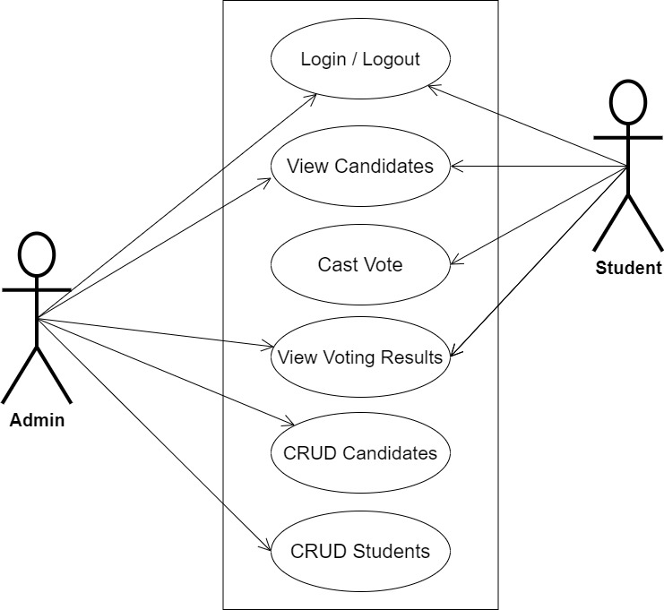
Human resources slide 7
SYSTEM MODELING (USE CASE DIAGRAM)

Slide 11
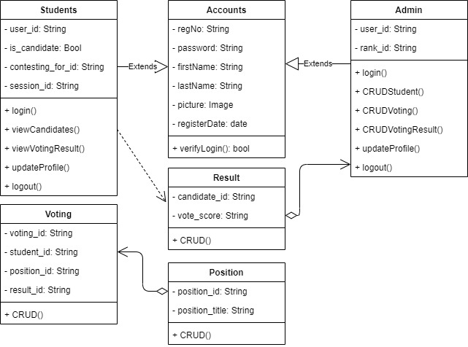
Human resources slide 7
SYSTEM MODELING (CLASS DIAGRAM)

Slide 12
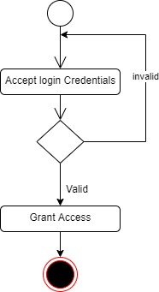
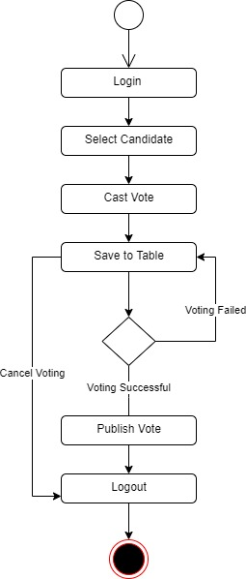
Human resources slide 7
SYSTEM MODELING (ACTIVITY DIAGRAM)
User Login Activity
Voting Activity

Slide 13
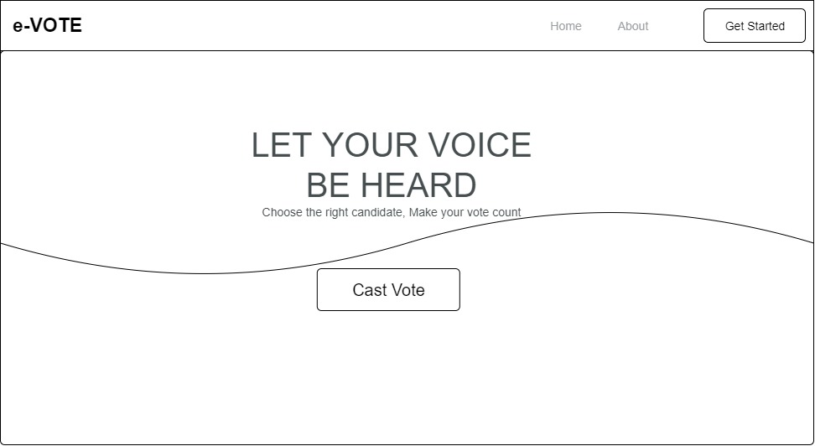
Human resources slide 7
PROPOSED INTERFACE DESIGN
Home Page

Slide 14
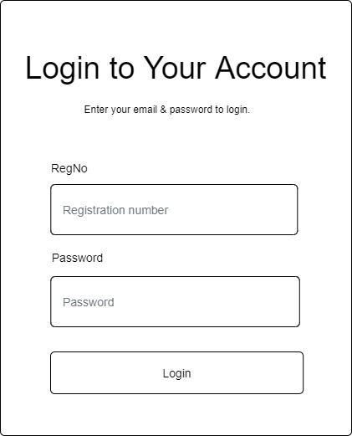
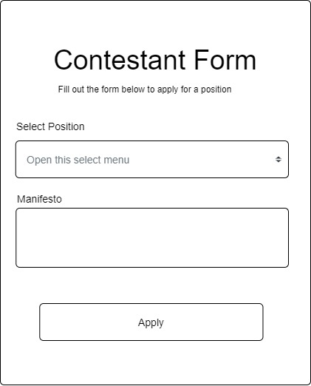
Human resources slide 7
PROPOSED INTERFACE DESIGN
Login Screen
Contestant Form

Slide 15

Human resources slide 9
Summary
This project focuses on the design, implementation, and assessment of a web-based e-voting system that is safe, easy to use, accessible, and complies with web accessibility standards, as well as the procedures of voter registration, authentication, and auditing. The scope of this project will be limited to the computer science department at Kaduna Polytechnic

Slide 16

Human resources slide 10
Thank You

